Slide 1
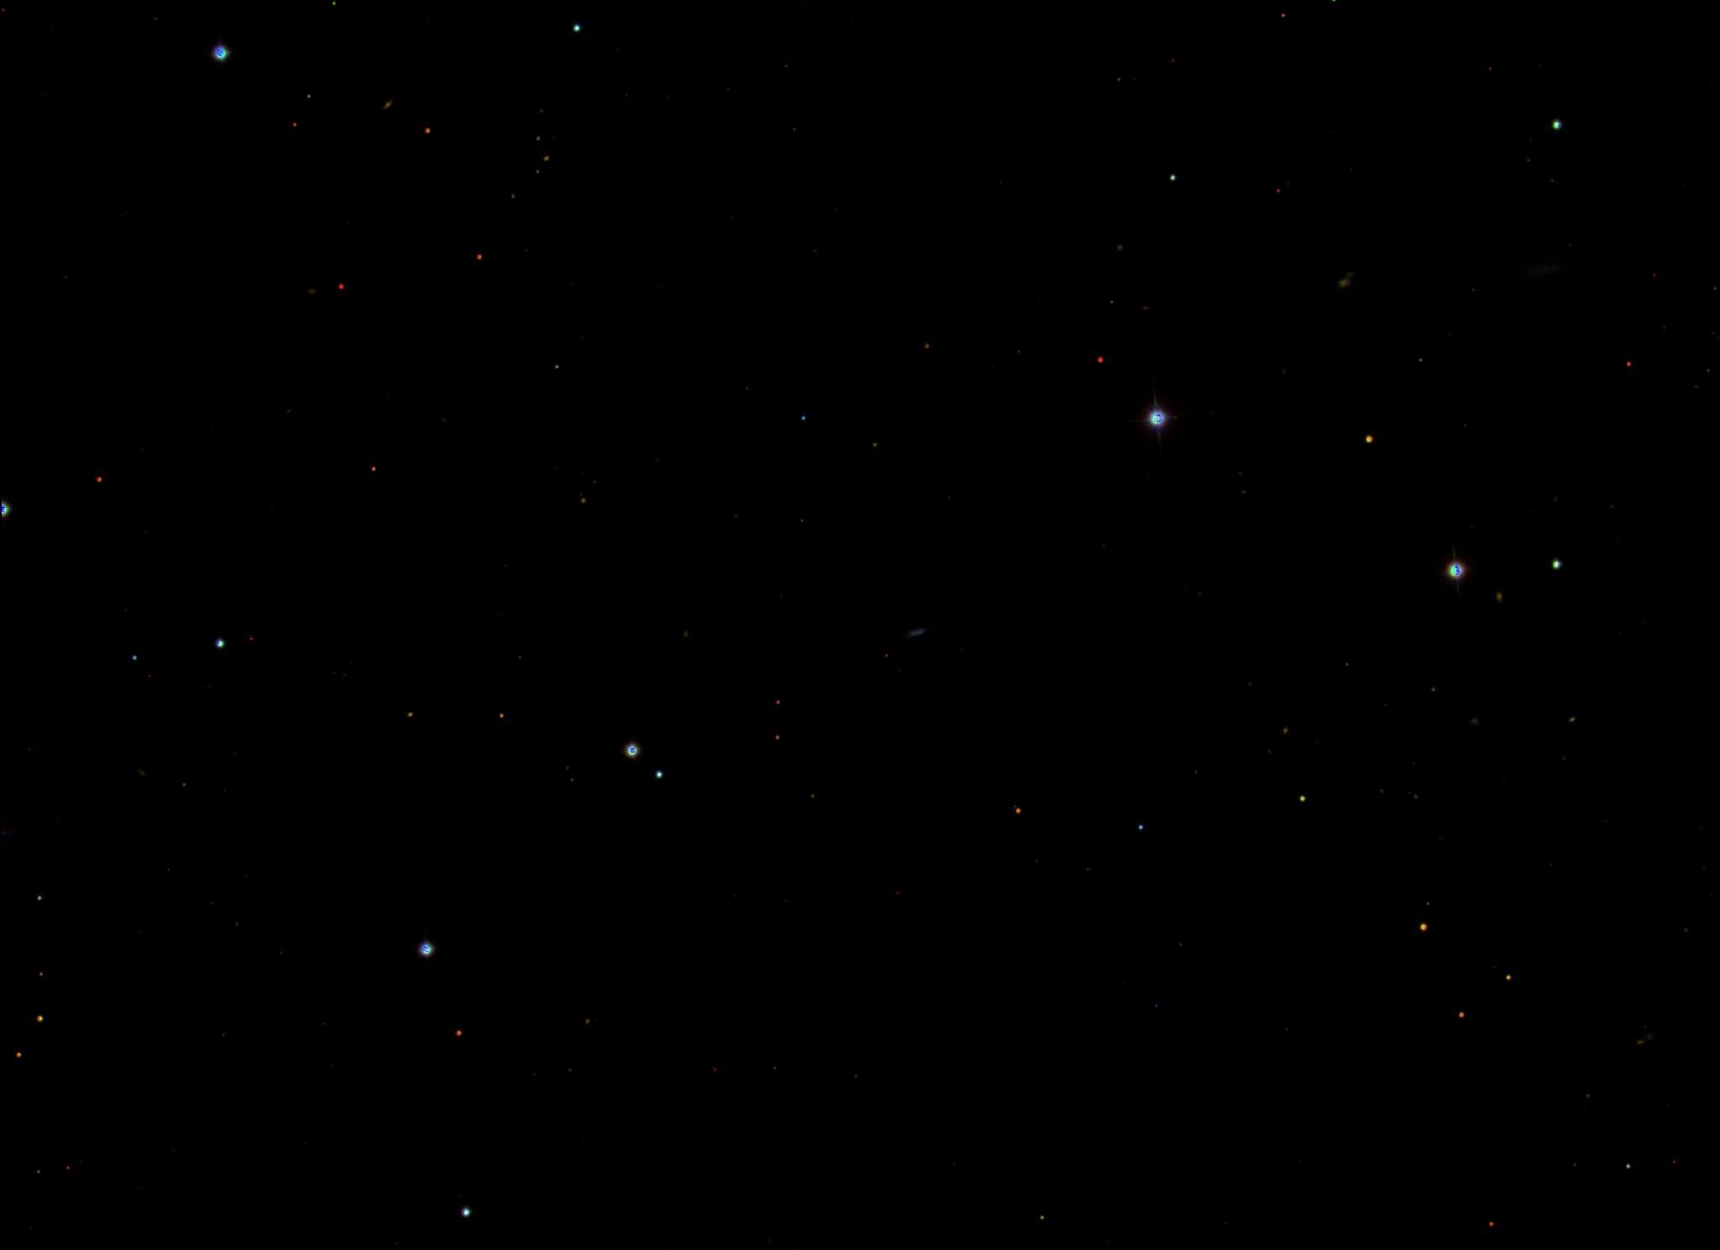


Slide 3





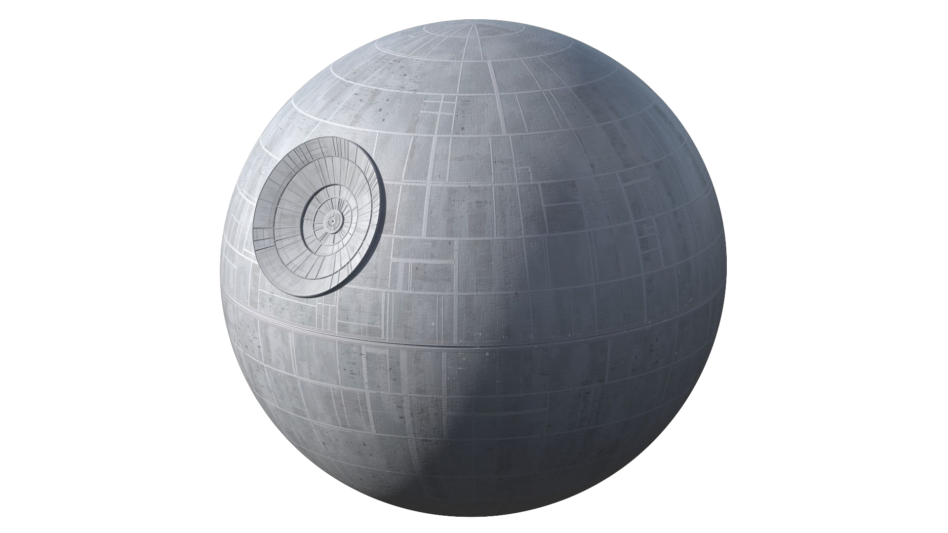

As the body moves away, its light is more stretched as it moves to the red end of the spectrum.
Classifying the various celestial bodies found in our dataset.
Understanding the movement of celestial objects by analyzing their redshift and blueshift patterns.
As the body moves towards us, its light is compressed and becomes bluer.
By studying these shifts, we can determine the velocities and distances of these objects, contributing to our knowledge of galactic behavior.

Slide 4

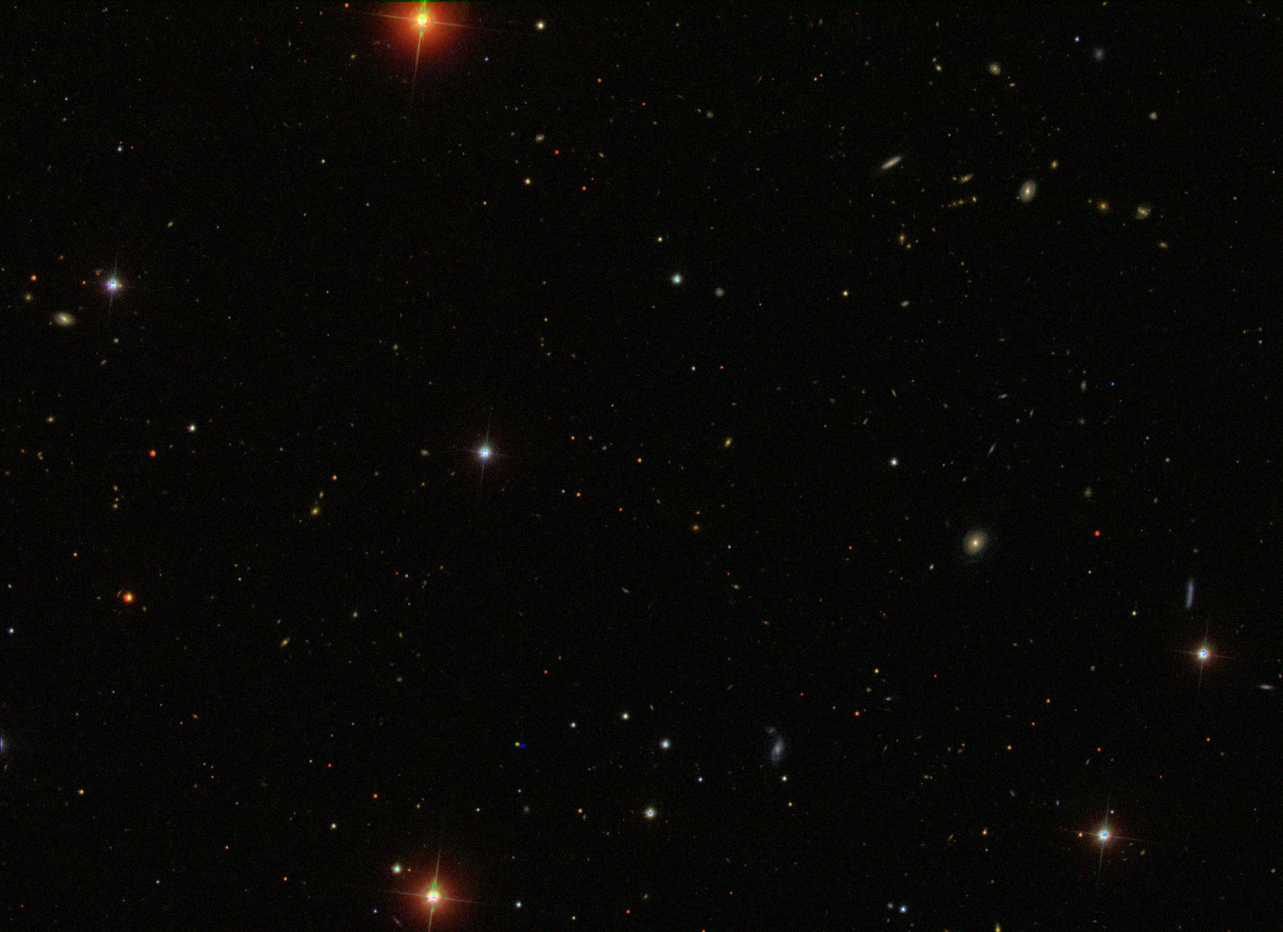
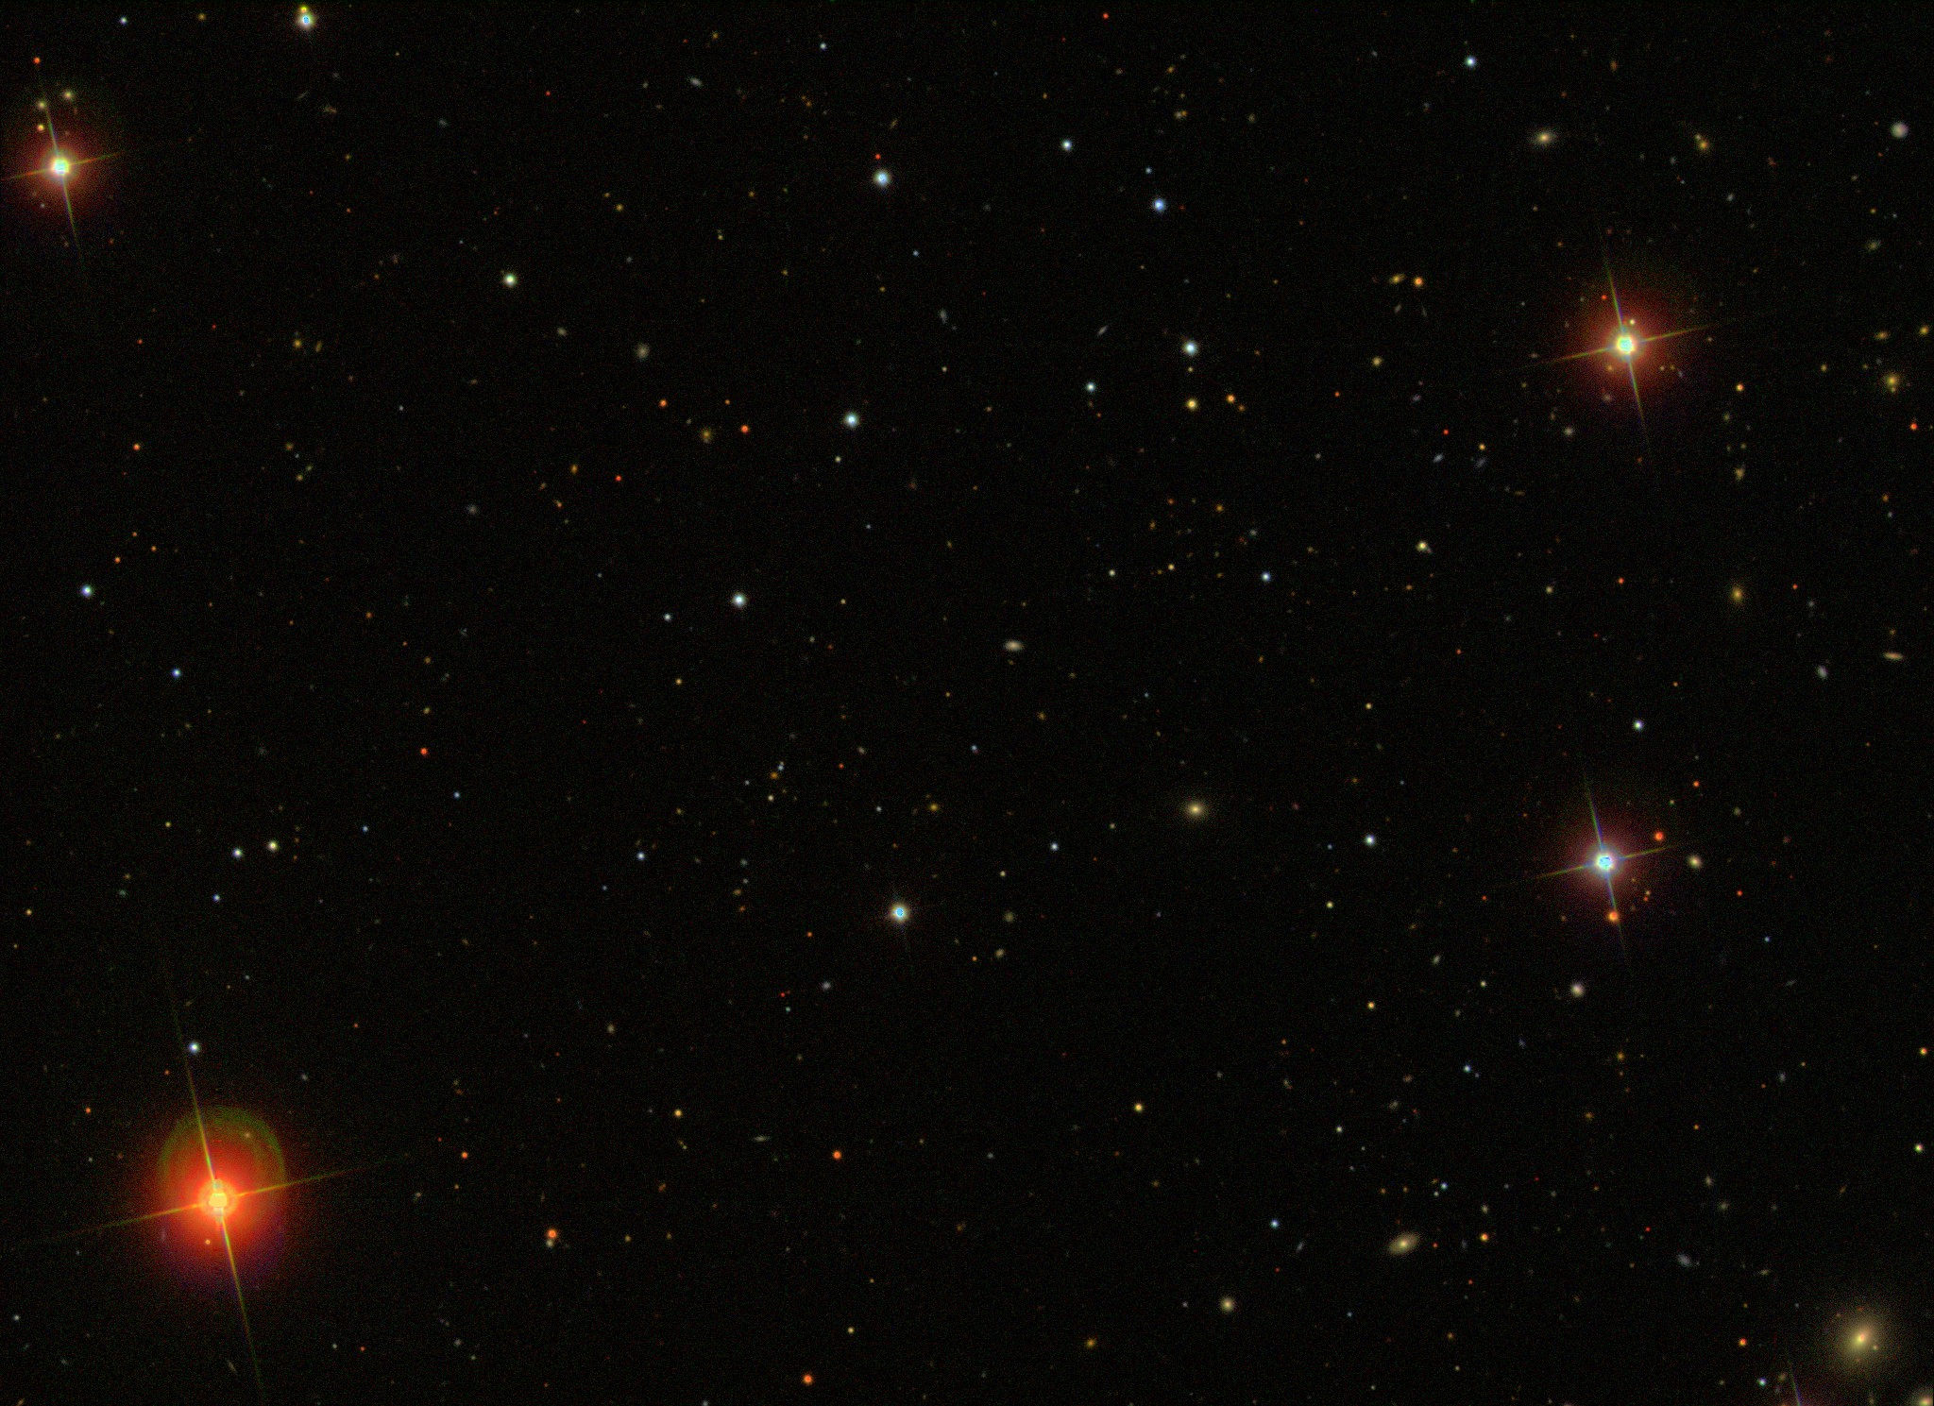

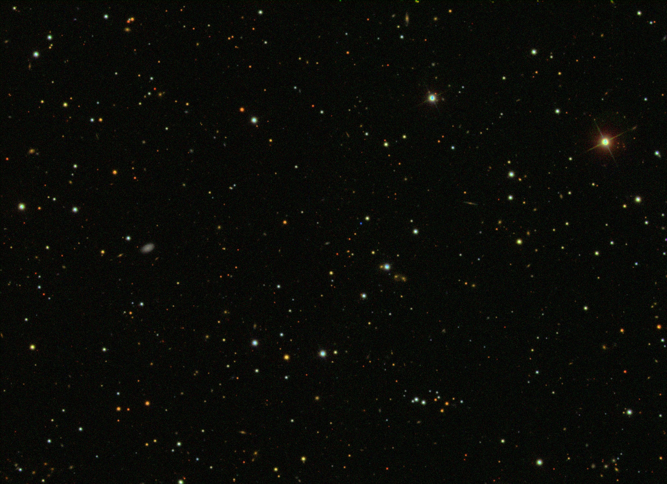
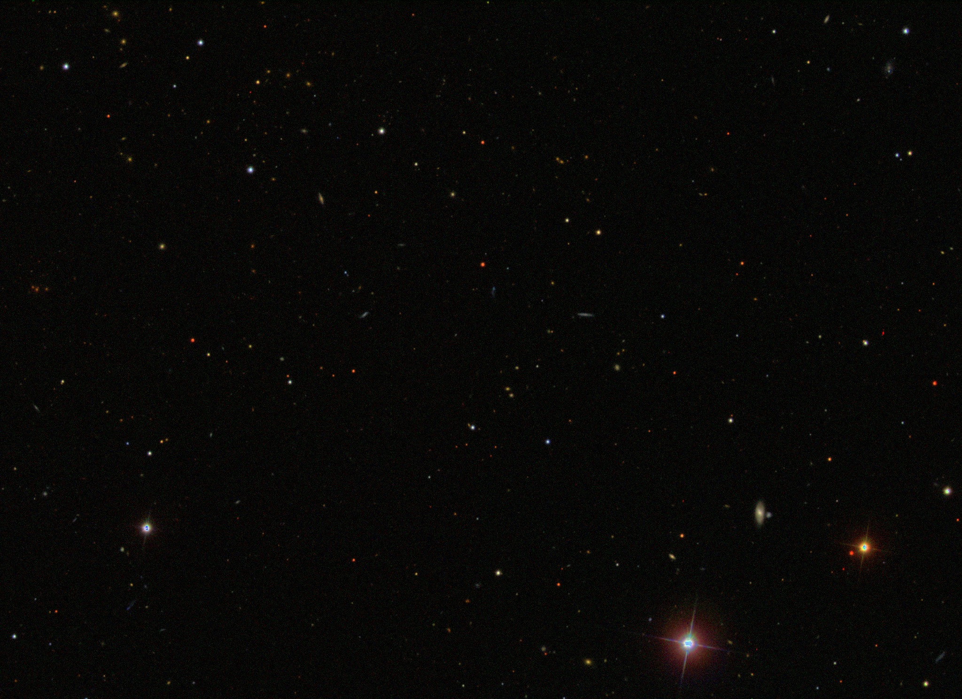


Astronomical images:
Spectroscopic Data: (17 features columns)
obj_ID = Object Identifier
alpha = Right Ascension angle (at J2000 epoch)
delta = Declination angle (at J2000 epoch)
u = Ultraviolet filter in the photometric system
g = Green filter in the photometric system
r = Red filter in the photometric system
i = Near Infrared filter in the photometric system
z = Infrared filter in the photometric system
cam_col = Camera column to identify the scanline within the run
spec_obj_ID = Unique ID used for optical spectroscopic objects (this means that 2 different observations with the same spec_obj_ID must share the output class)
plate = plate ID, identifies each plate in SDSS
MJD = Modified Julian Date, used to indicate when a given piece of SDSS data was taken

Slide 5
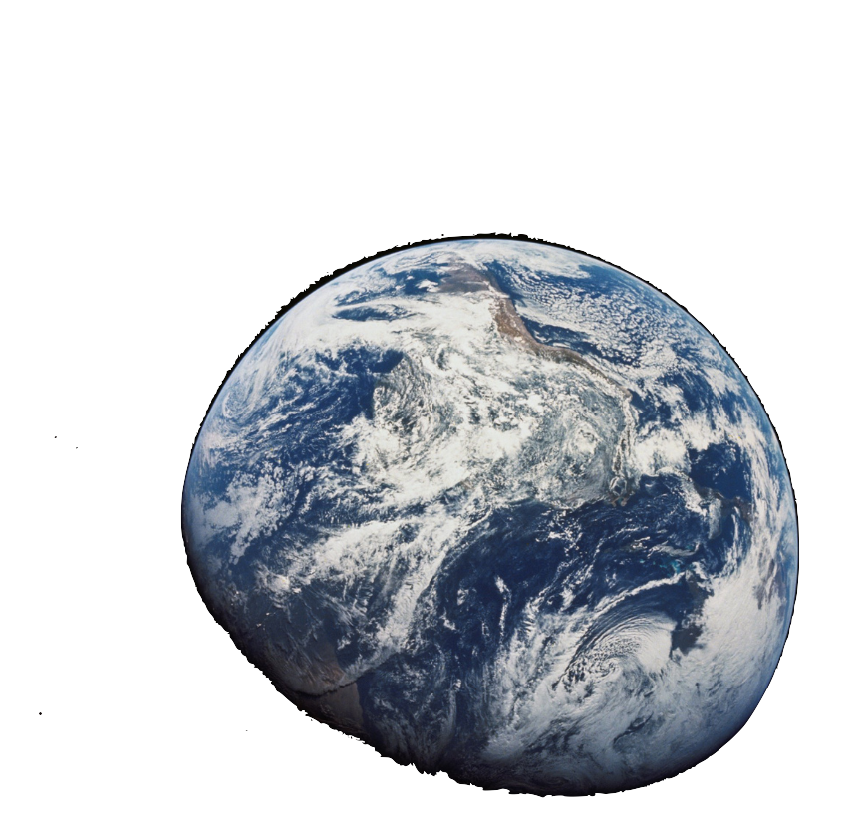
Objects classification
Model Selection: CNN
Tools and Libraries:
Python
Pandas,
Numpy
OpenCV, scikit-image
Matplotlib, Seaborn, Plotly
scikit-learn

Slide 6

By leveraging advanced image processing techniques, comprehensive tabular data, and cutting-edge machine learning model, it aims to provide a richer, more detailed understanding of galactic movement.

Slide 7


